Slide 1
NF Progress Update: (p)H vs (p)M
Full collaboration group meeting
05/15/2023

Slide 2
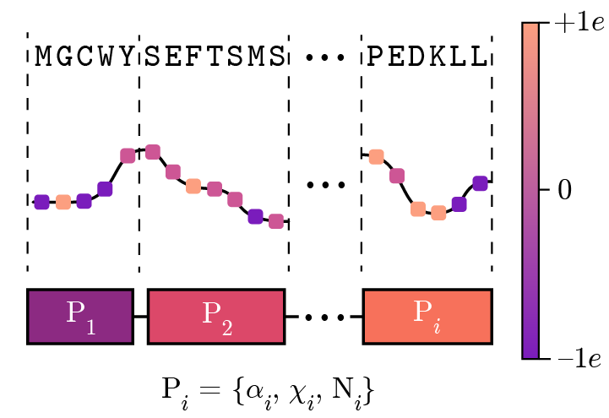
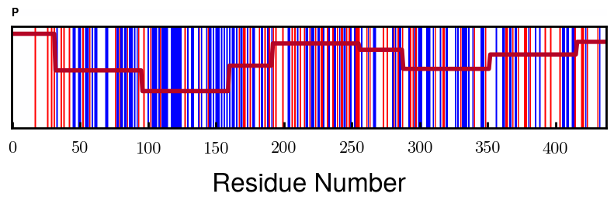
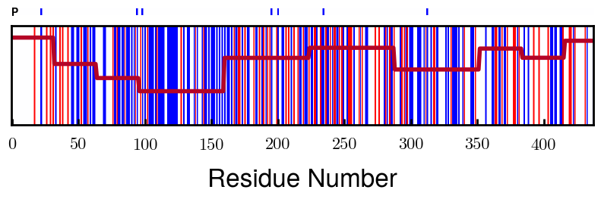
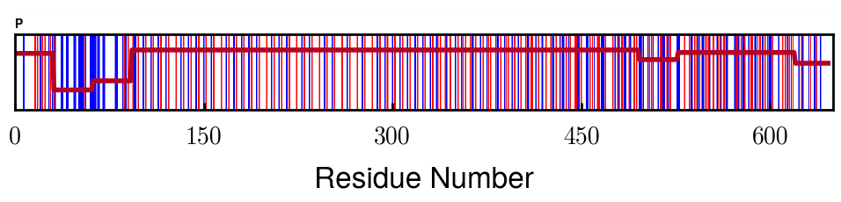
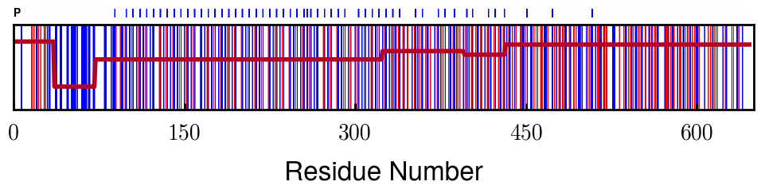
Protein Charge Distribution (Proposed SI)
Block | Alpha | Chi
[0 32] | 0.079143 | 1.275000
[32 64] | -0.186340 | 1.125000
[64 96] | -0.327964 | 1.181250
[96 160] | -0.460694 | 0.787500
[160 224] | -0.124999 | 1.115625
[224 288] | -0.023510 | 0.956250
[288 352] | -0.242085 | 1.00312
[352 384] | -0.031302 | 1.125000
[384 416] | -0.123860 | 1.050000
[416 438] | 0.046945 | 1.281818
Amino acid
Algorithm overview
Charge (at given pH)
Block assignment
NFM
> 0e
= 0e
< 0e
NFH

Slide 3
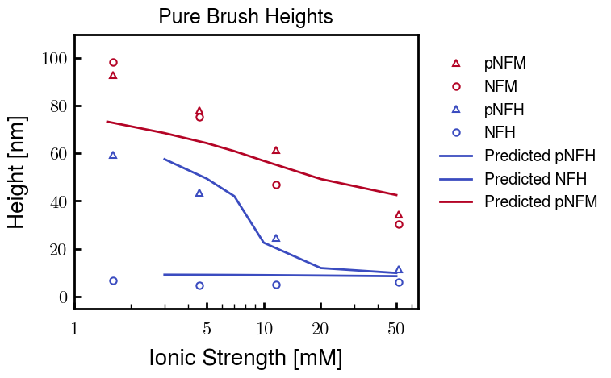
Height comparisons (Proposed Figure)
Notes:
NFH is essentially finished;
Fine tuning for a closer fit
More points to smoothen out pNFH curve
pNFH and NFH use same b, v values
pNFM fitting still in progress
NFM fitting will follow; expecting little difference

Slide 4
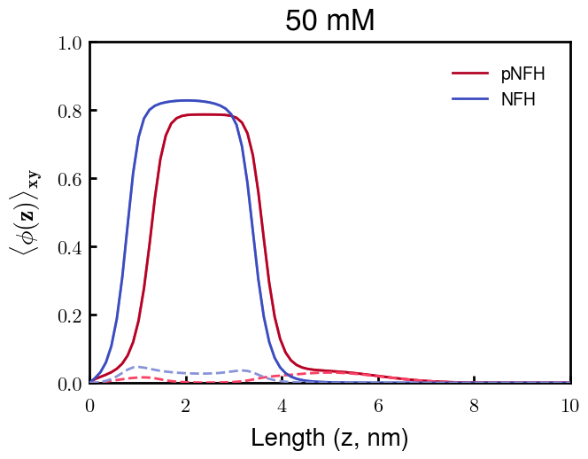
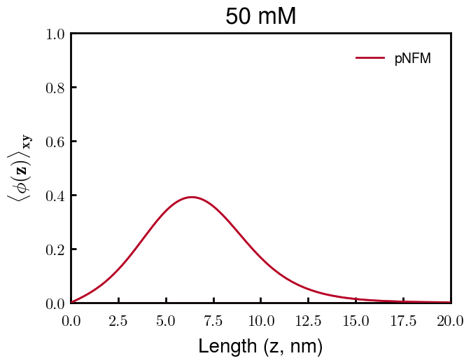
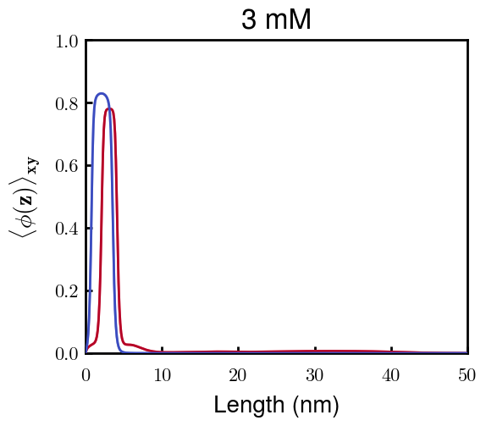
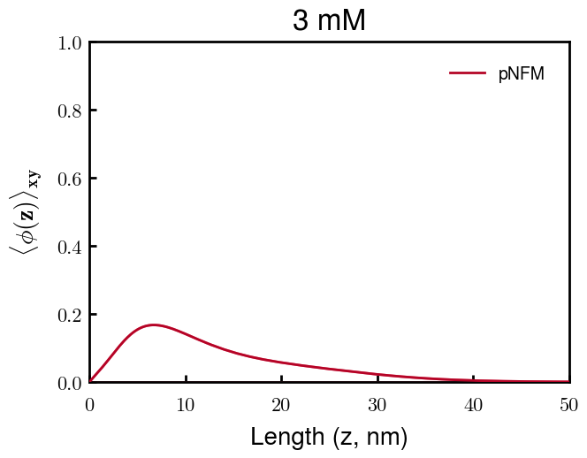
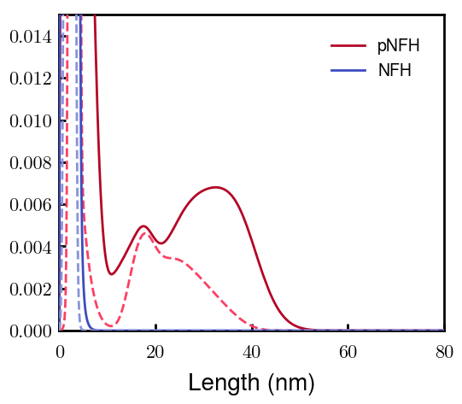
Density profiles (Proposed Figure)
Changes:
Block 2 (negative block) dashed
Block 3 (phos block) dashed

Slide 5
Discussion
Height fit (over all Cs) with experimental data gives confidence for calculated density profiles
Coarse-graining (fitting) parameters
b : Kuhn’s statistical segment length (spring equil. distance)
NFH: 0.50 nm, NFM: 3.00 nm
v : Volume of Kuhn’s segment (spring volume)
NFH: 0.20 nm³, NFM: 2.00 nm³
Stiffness parameter, p = b³/v (spring constant)
NFH: 0.625, NFM: 13.5
b

Slide 6
Next Steps
Fine tuning of parameters for best fit with height profiles of L-H brush
Role of charge distribution of NFH at biological pH
Charge of heterogeneous negative block of NFH (blocks 2 & 3)
L-H brushes after phosphorylation
L-M brushes (once experiments are finished)

Slide 7


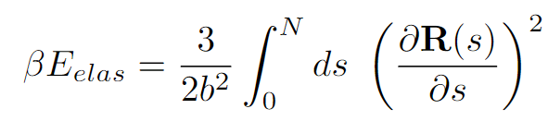
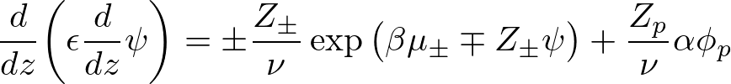
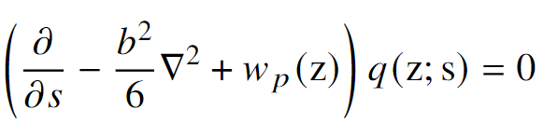
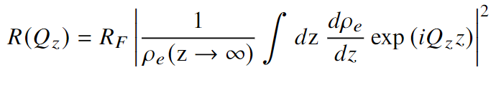
Equations

Slide 8
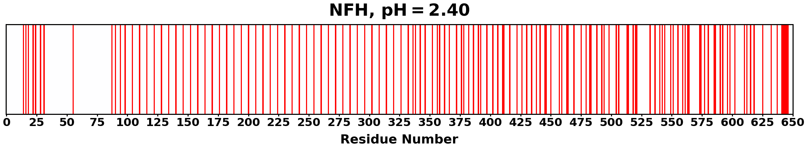
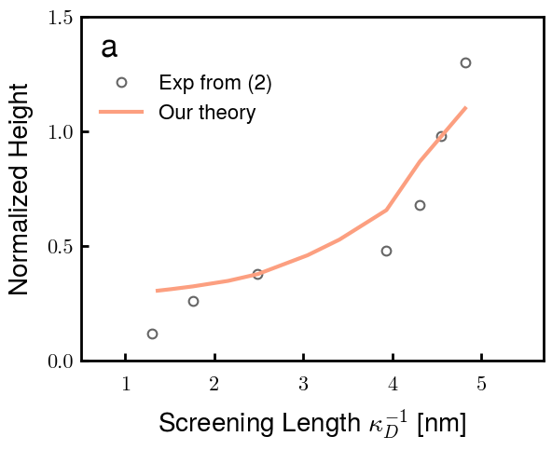
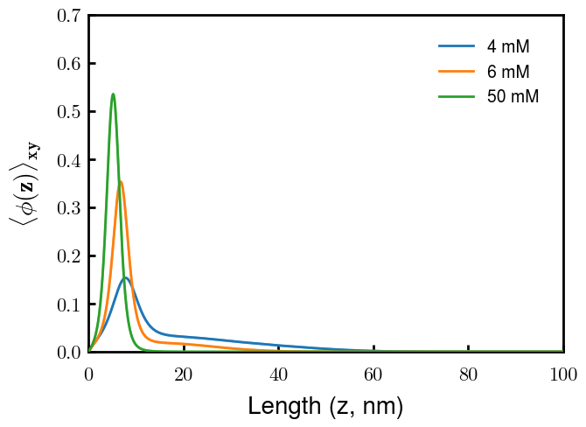
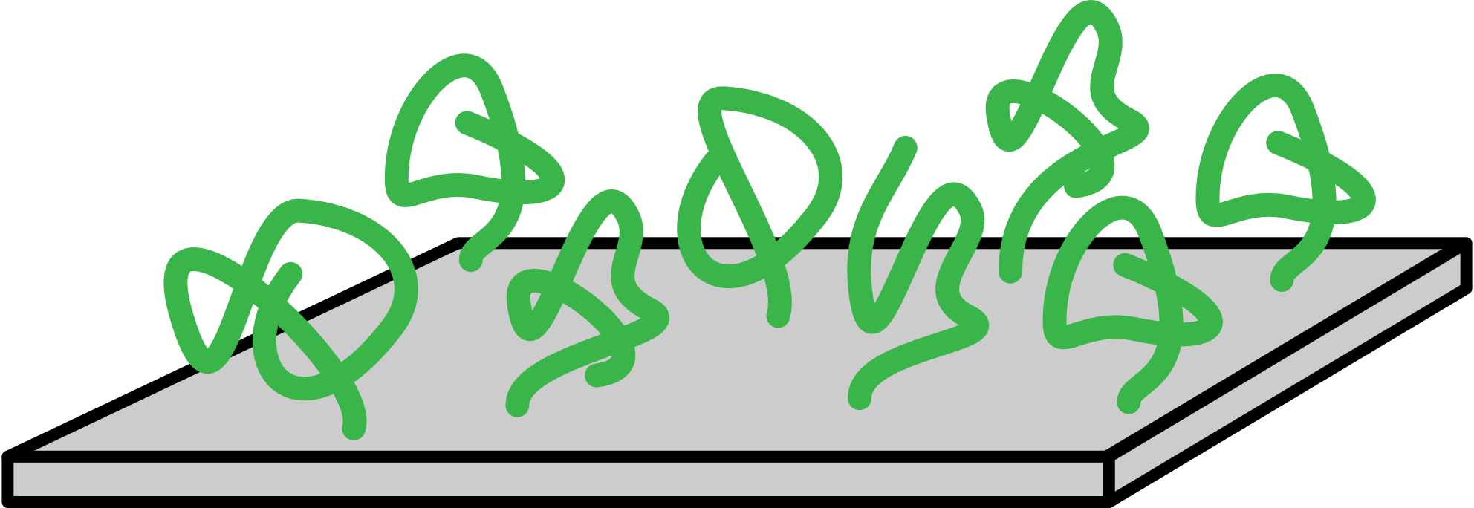
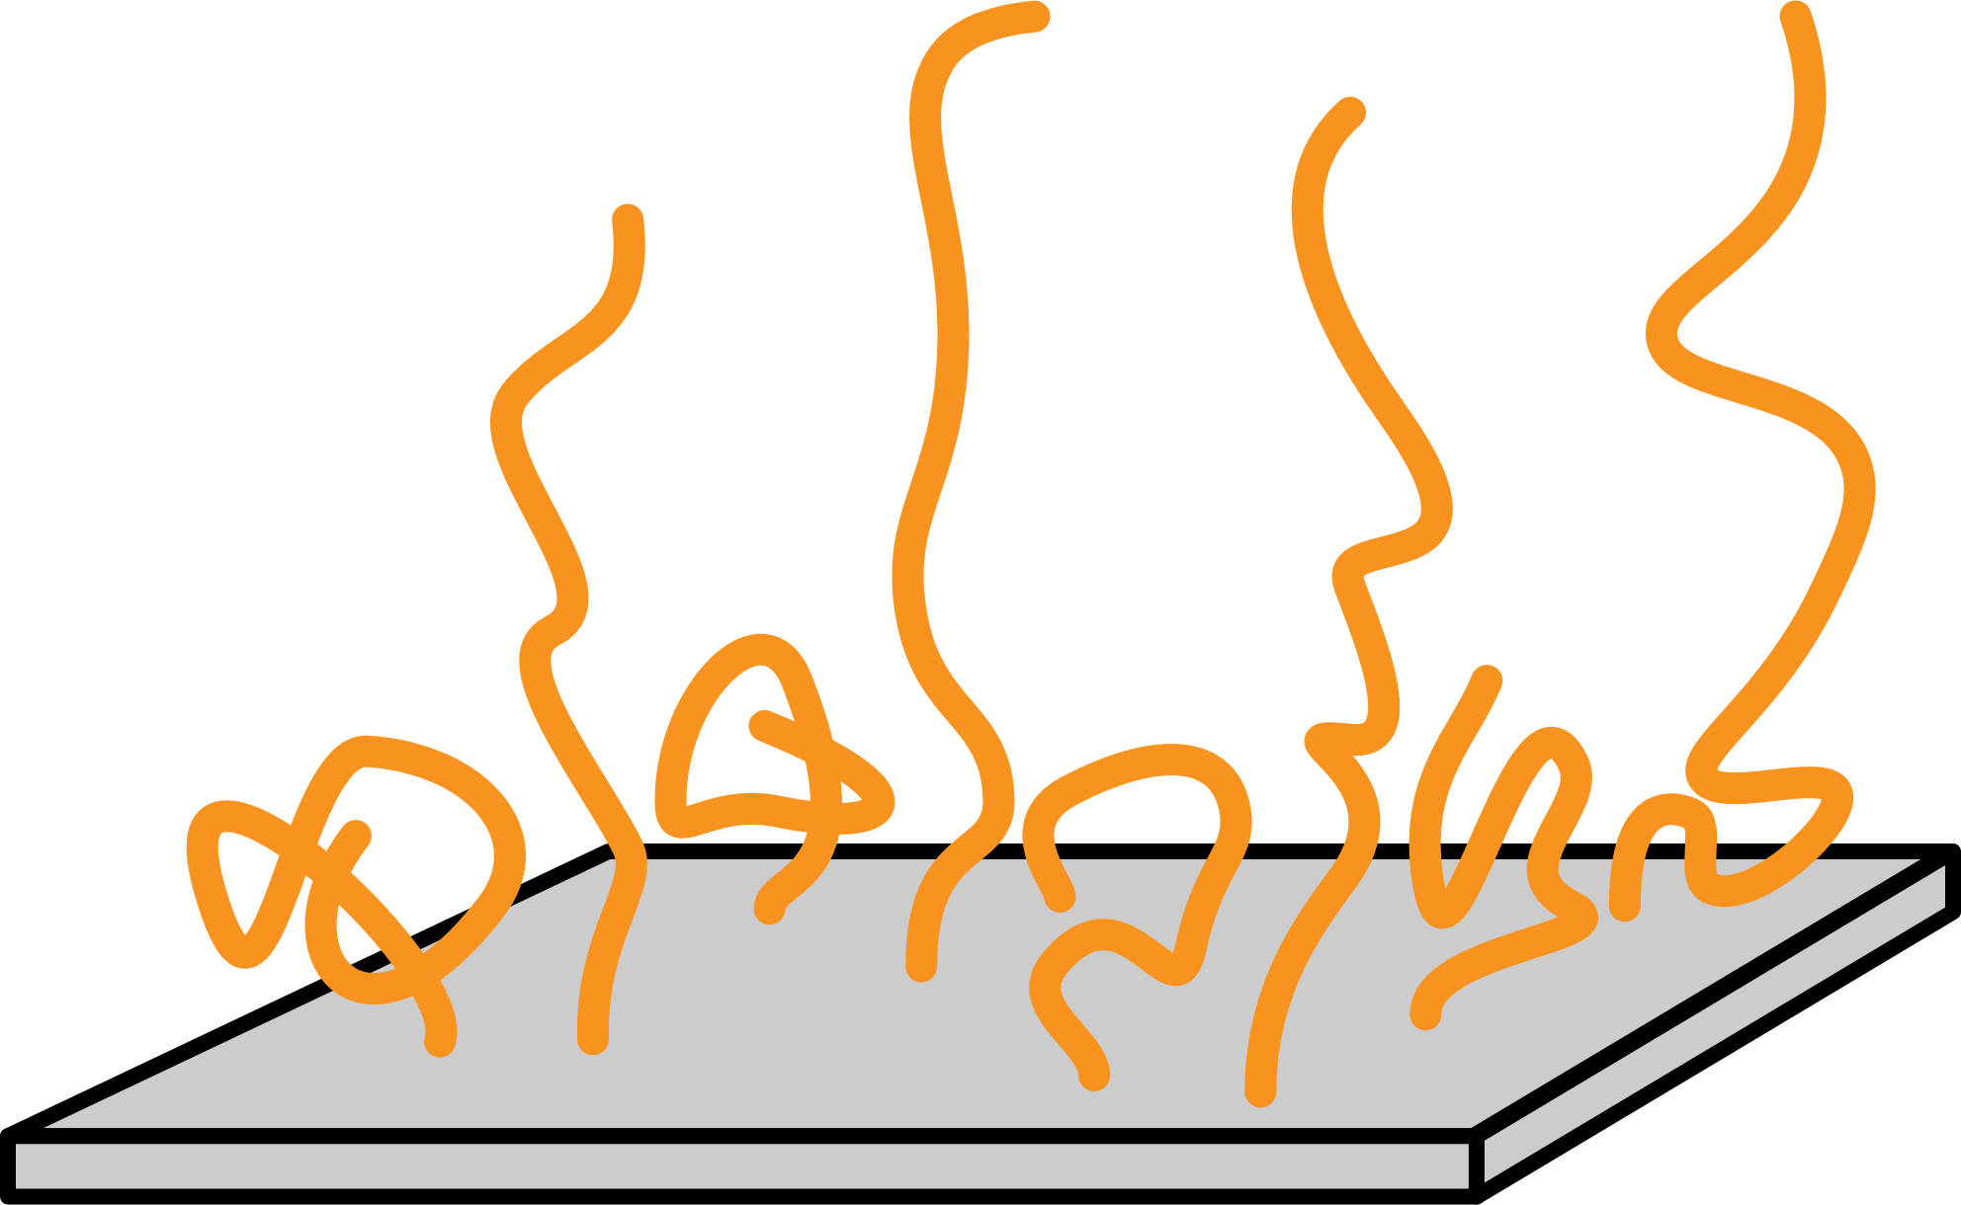
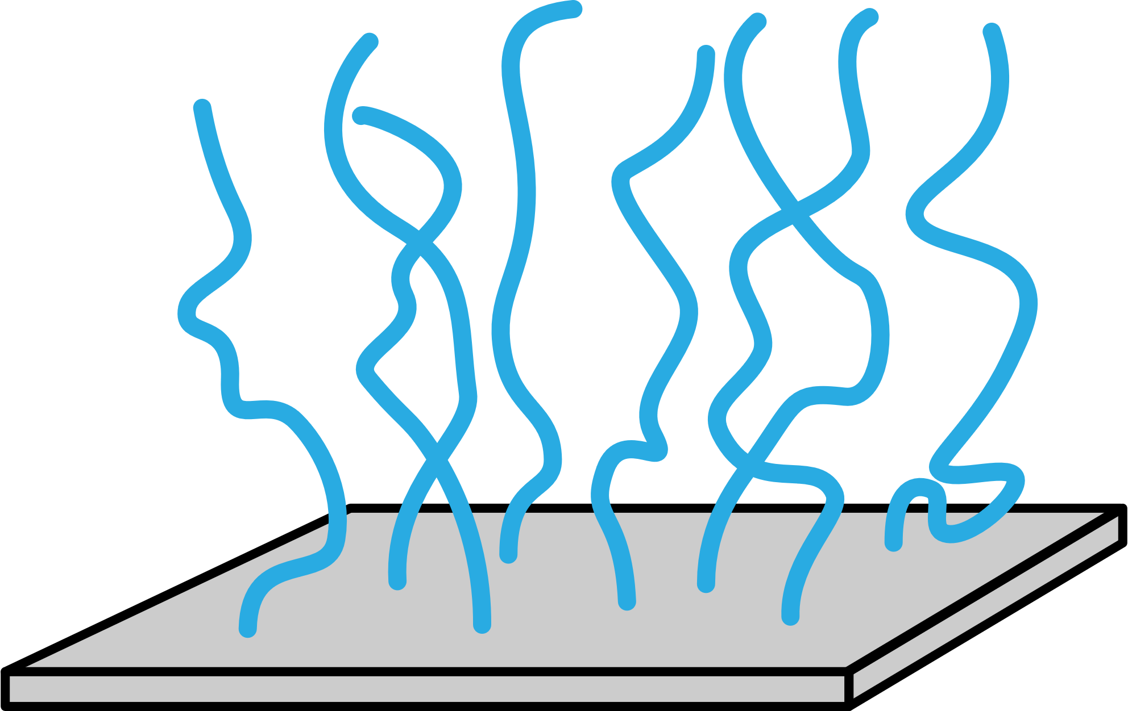
Summary of Model Capabilities (Srinivasan 2014)

Slide 9
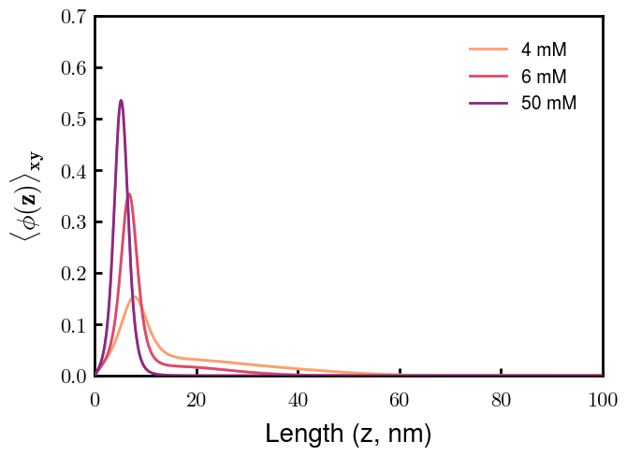
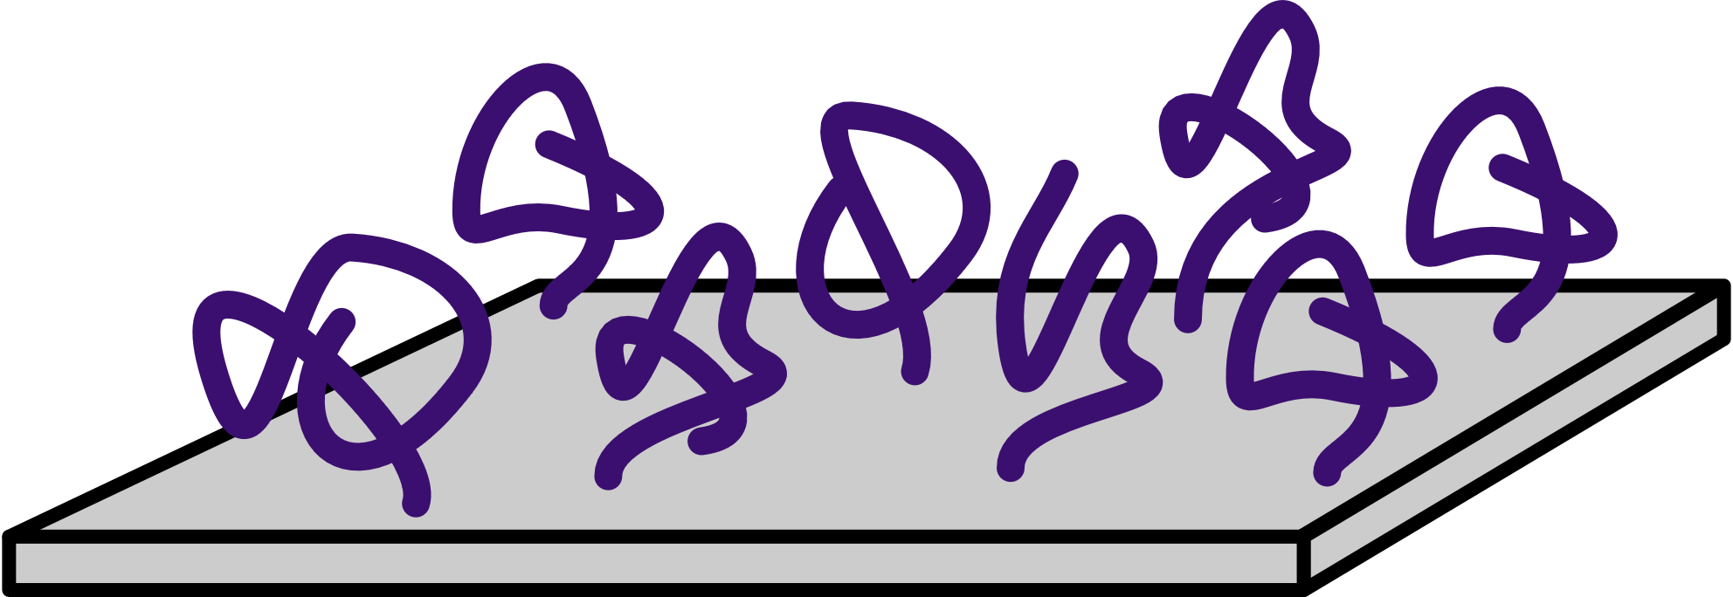
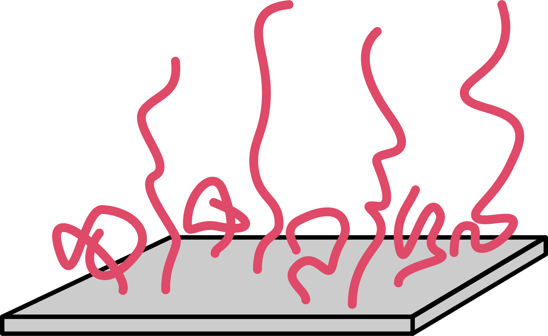
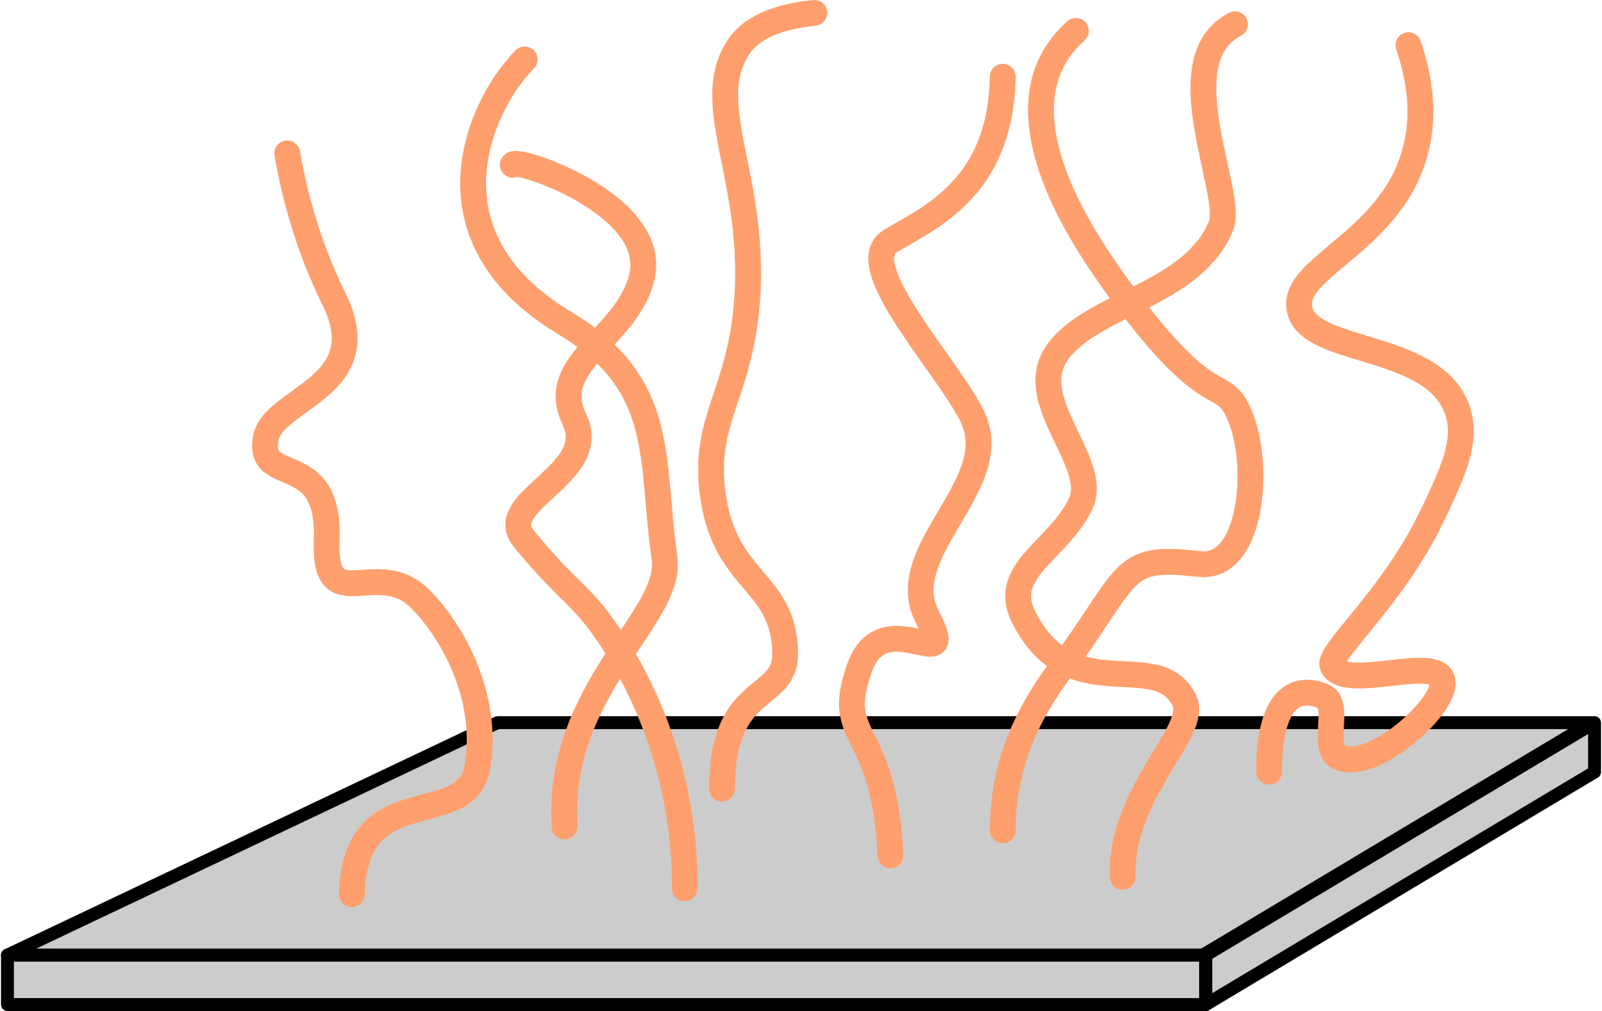

Slide 10
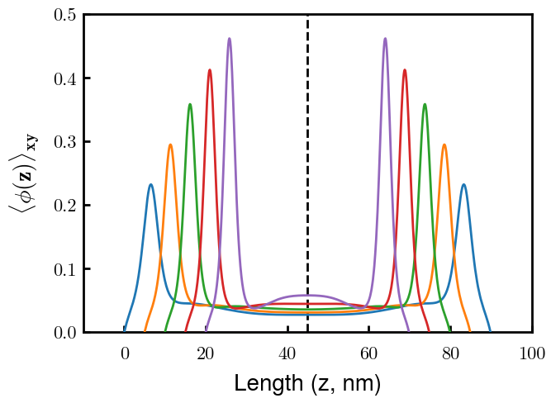
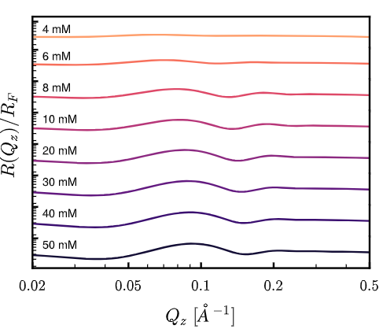
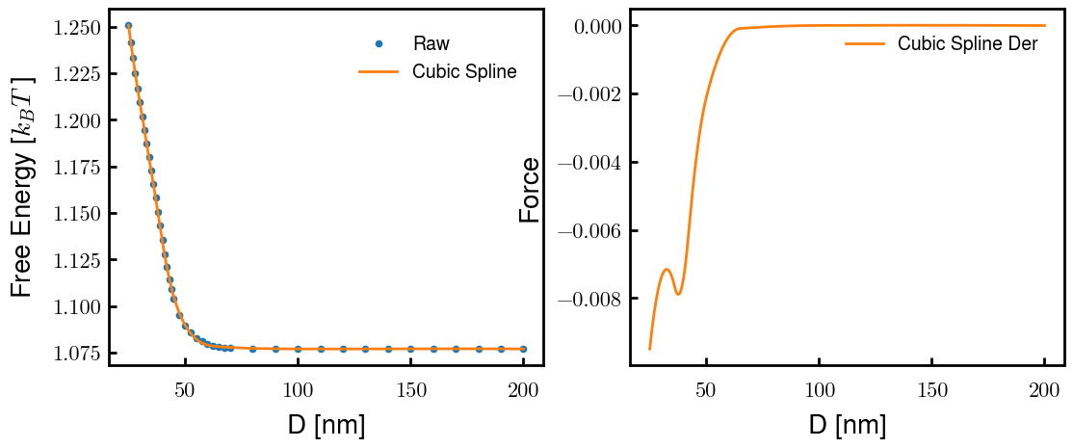
Characterization
Interacting Brushes (4 mM)
Reflectivity Spectra
Emergence of inner condensed phase

